Slide 1


ME 322: Machine Design
Hydrostatic Bearings
Prof. S. K. Kakoty

Slide 2
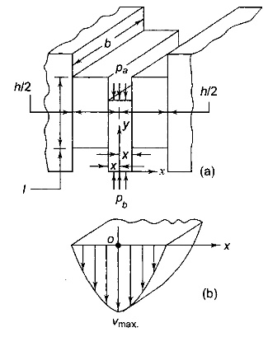
Viscous flow through Rectangular slot
The flow of lubricating oil through a rectangular slot is shown in Fig.1:
l is the length of the slot in the direction of flow, while b and h are the dimensions of the slot in a plane perpendicular to the direction of flow.
.
Fig 1: (a)Viscous flow through Rectangularslot (b) Velocity distribution

Slide 3
Side leakage neglected as the dimension b is very large compared to h
The pressure difference between the two sides of the central slice is
The downward force due to this pressure difference is area multiplied by the pressure difference ( ∆p).
On account of this force, the rectangular slice of width ( ) is extruded down.
The shear resistance on both surfaces of the slice is due to the viscosity of the lubricant.
According to Newton’s law,
where ν is the velocity in the Y direction.

Slide 4
Considering equilibrium of forces in the vertical direction,
The negative sign is introduced as the velocity ν decreases when x increases.
Integrating the expression,
The constant C of integration is evaluated from the boundary condition,
Therefore,

Slide 5
From (a) and (b),
The velocity distribution along x-axis is parabolic as shown in Fig.1(b).
The maximum velocity at the centre (x=0) is given by
For parabolic profile, the average velocity is two-third of the maximum velocity,
The fundamental equation for flow (Q) of the lubricant through the rectangular slot is given by

Slide 6
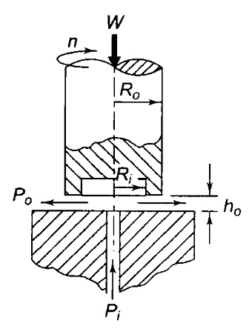
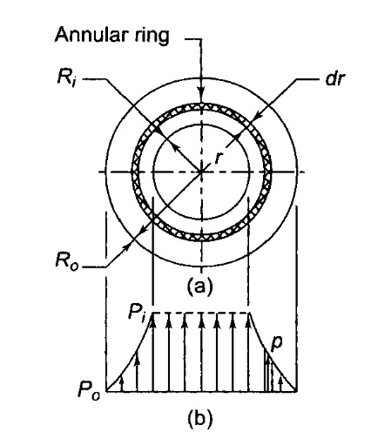
Hydrostatic step bearing
The lubricant is flowing radially outward through the annulus of radii R_{i} and R_{o} and leaves at the periphery of the shaft (Fig. 2). Consider an elemental ring of radius r and thickness (dr) as shown in Fig. 3 (a).
The flow of the lubricant through this elemental ring is given by
Fig 2: Hydrostatic step bearing
Fig 3: (a) schematic diagram (b) Pressure distribution

Slide 7
Notations
W = thrust load (N)
R_{o}= outer radius of the shaft (mm)
R_{i}= radius of the recess or the pocket (mm)
P_{i}= supply of inlet pressure (N/mm2) or (MPa)
P_{o} = outlet or atmospheric pressure (N/mm2) or (MPa)
h_{o} = fluid film thickness (mm)
Q= flow of the lubricant (mm³/s)
μ = viscosity of the lubricant (N-s/mm²) or (MPa-s)

Slide 8
The length l in the direction of flow is (dr) while the width b is (2πr) and
substituting these quantities
The negative sign is introduced in the equation because pressure decreases as the radius r increases or (dp/dr) is negative.
Rearranging the terms,
Integrating
………………….. (1)

Slide 9
The constant C of integration is evaluated from the boundary condition, p = 0 when r = R_{o}
therefore
Substituting the value of C in Eq. (1)
………….. (2)
The second boundary condition is
Substituting these values in Eq. (2),
………….. (3)

Slide 10
The above equation is used to calculate the flow requirement of the bearing.
The pressure distribution is shown in Fig. 3 (b).
Load carrying capacity
…..……… (4)
substituting Eq. (2) in the above expression,
…………. (5)
consider the integral,

Slide 11
substituting the values of u and v,
Therefore,
Substituting the value of p and Q in Eq. 5, we have
…………….. (6)
The above equation can be used even if there is no recess, in which case, will be the radius of oil supply pipe.

Slide 12
Energy losses in Hydrostatic bearing
The total energy loss in a hydrostatic step bearing consists of two factors—the energy required to pump the lubricating oil and energy loss due to viscous friction.
The energy E_{p} required to pump the oil is given by,
Therefore,
Where (kW)_{p} is the power loss in pumping (in kW).

Slide 13
The frictional power loss is determined by considering the elemental ring of radius (r) and radial thickness (dr) illustrated in Fig. 2(a).
The viscous resistance for this ring is (dF). It is determined by Newton's law of viscosity.
According to this law,
Substituting,
The frictional torque is given by

Slide 14
Integrating,
The unit of is (N-mm).

Slide 15
Therefore,
……………… (7)

Slide 16
Numerical Problems

Slide 17
Example 1
The following data is given for a hydrostatic thrust bearing:
thrust load = 500 kN
shaft speed = 720 rpm
shaft diameter = 500 mm
recess diameter = 300 mm
film thickness = 0.15 mm
viscosity of lubricant = 160 SUS
specific gravity = 0.86
Calculate
supply pressure;
flow requirement in litres/min;
power loss in pumping; and
frictional power loss.

Slide 18
Solution:
Given, W= 500 kN, n = 720 rpm, Do = 500 mm, Di= 300 mm, h0 = 0.15 mm, ρ = 0.86 viscosity = 160 SUS

Slide 21
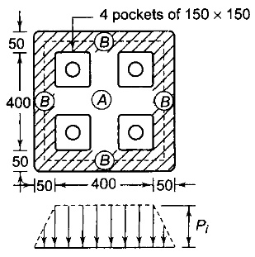
Example 2
The pad of a square hydrostatic thrust bearing, with four pockets of 150 x 150 mm is shown in the following figure. The thrust load is 500 kN and the film thickness is 0.15 mm. The viscosity of the lubricant is 250 cP. The pressure in the area A bordering the pockets can be assumed to be uniform and equal to the supply pressure. The pressure distribution in the area B (shown by hatching lines) is assumed to be linear, varying from supply pressure at the inner edge to atmospheric pressure at the outer edge. For calculating the flow of the lubricant, it can be assumed that the area B is straightened out and has length equal to the mean length shown by the dotted line.
Calculate
supply pressure; and
flow requirement in litres/min

Slide 22
Solution
Given W= 500 kN h_{o} = 0.15 mm z = 250 cP
i. Supply pressure
The pressure in the area A is the supply pressure P _{i} while the average pressure in the area B is
Therefore,
ii. Flow requirement
When the area B is straightened out, its length is equal to (450 x 4) or 1800 mm.

Slide 24
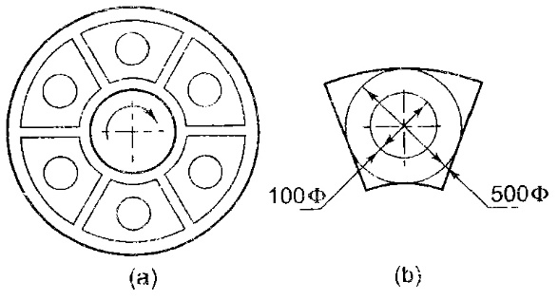
Example 3
The hydrostatic thrust bearing of a generator consists of six pads as shown in Fig.17(a). The total thrust load is 900 kN and the film thickness is 0.05 mm. The viscosity of the lubricant is 300 SUS. Neglecting the flow over corners, each pad can he approximated as a circular area of 500 mm and 100 mm as outer and inner diameters respectively. This is shown in the following figure. The density of the lubricating oil is 0.9 g/cc.
Calculate
the supply pressure
the flow requirement
Fig. 17: (a) Six pad Bearing (b) Dimensions of Pad

Slide 25
Solution:
Given
W= (900/6) kN, D₀=500mm, D_{i}=100mm
H₀=0.05mm, 𝜌=0.9, Viscosity=300 SUS
i. Supply Pressure
The load acting on each pad is given by

Slide 26
ii. Flow requirement

Slide 27
Thank you

